Slide 1


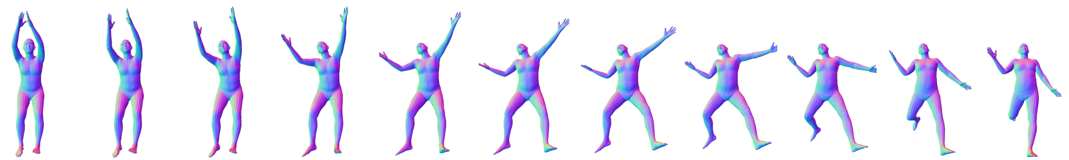
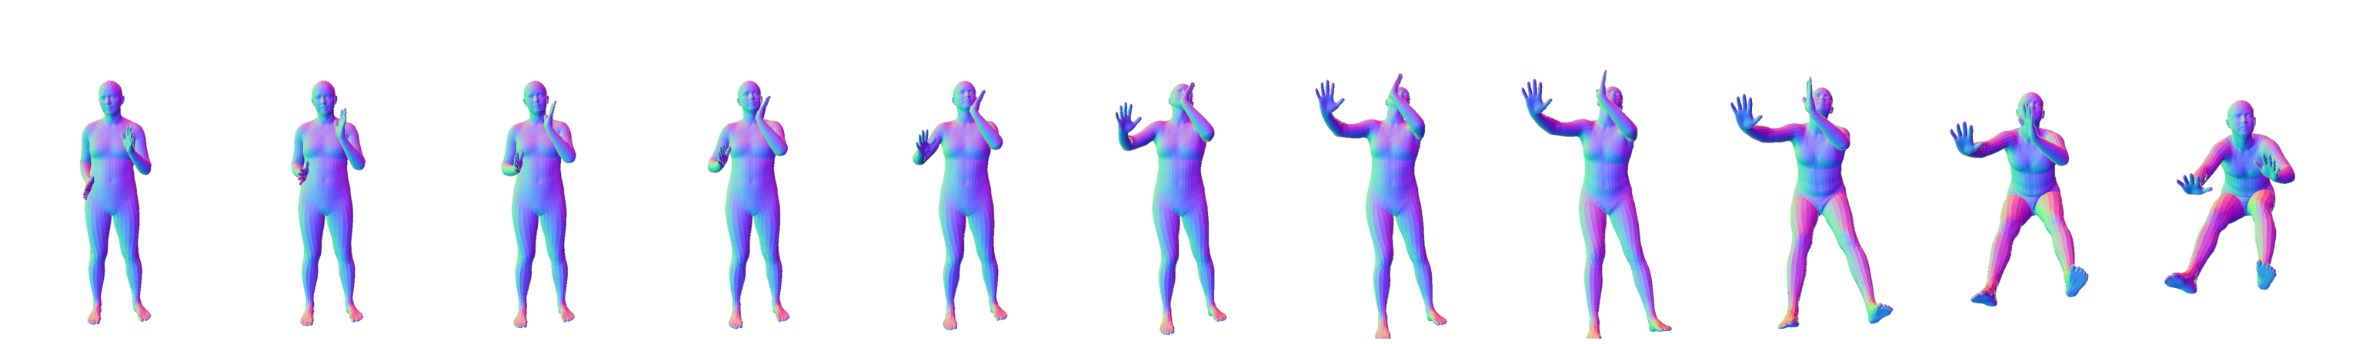
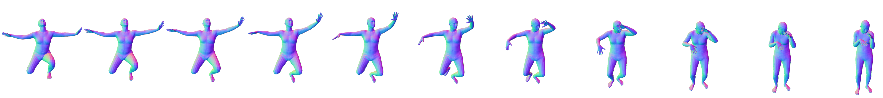
Adversarial Parametric Pose Prior
Andrey Davydov, Anastasia Remizova, Victor Constantin,
Sina Honari, Mathieu Salzmann, Pascal Fua
CVLab, EPFL
Notes:
We present our paper Adversarial Parametric Pose Prior.
In recent years, the problem of careful tackling of the human body has arisen.

Slide 2
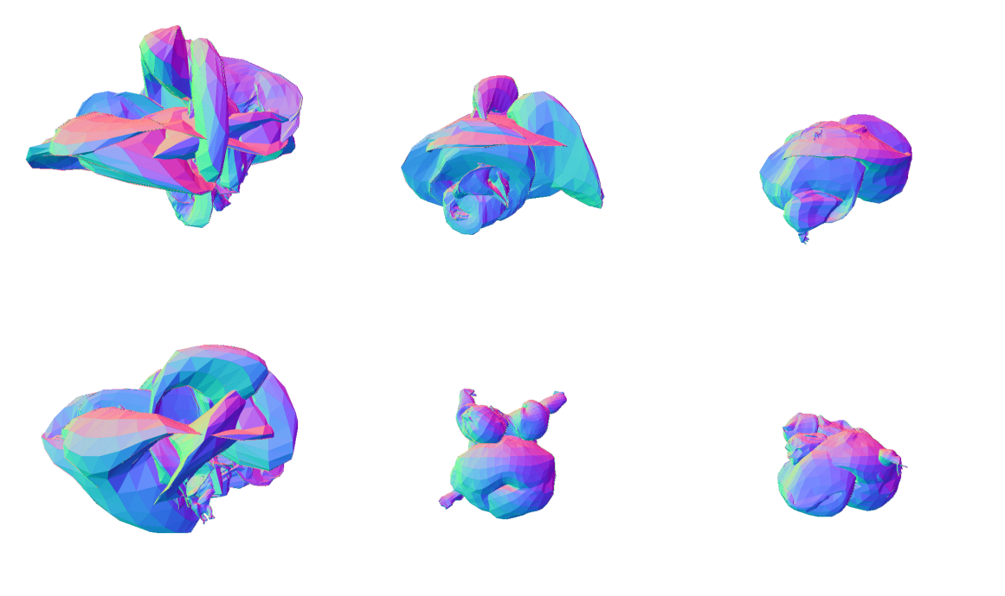
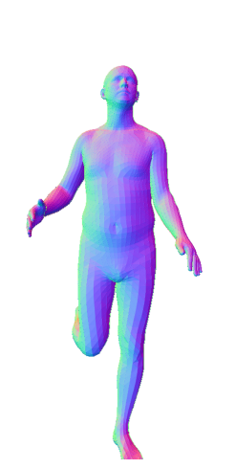
Human Body Priors
Limitation
input pose is not bounded to realistic bodies
SMPL (Skinned Multi-Person Linear Model)
shape
(PCA)
SMPL
renderer
pose
(joint angles)
SMPL: A Skinned Multi-Person Linear Model. Loper et al., SIGGRAPH Asia, 2015
Notes:
One of the simplest yet very effective models is SMPL:
meshes are parametrized by shape parameters (learned as PCA weights) and pose (in the form of rotations in joints).
However, not all pose and shape values yield physically-plausible or even realistic body meshes.

Slide 3
Proposed pose prior
SMPL
Ours
SMPL
renderer
fixed
SMPL
renderer
Notes:
Instead of using SMPL body renderer directly,
we propose to learn a prior that restricts the pose parameters to values that produce realistic poses. Then, at inference time, to generate a plausible body, our approach allows to sample random latent vectors and feed them into pretrained generative model that yields a vector of plausible SMPL pose.

Slide 4
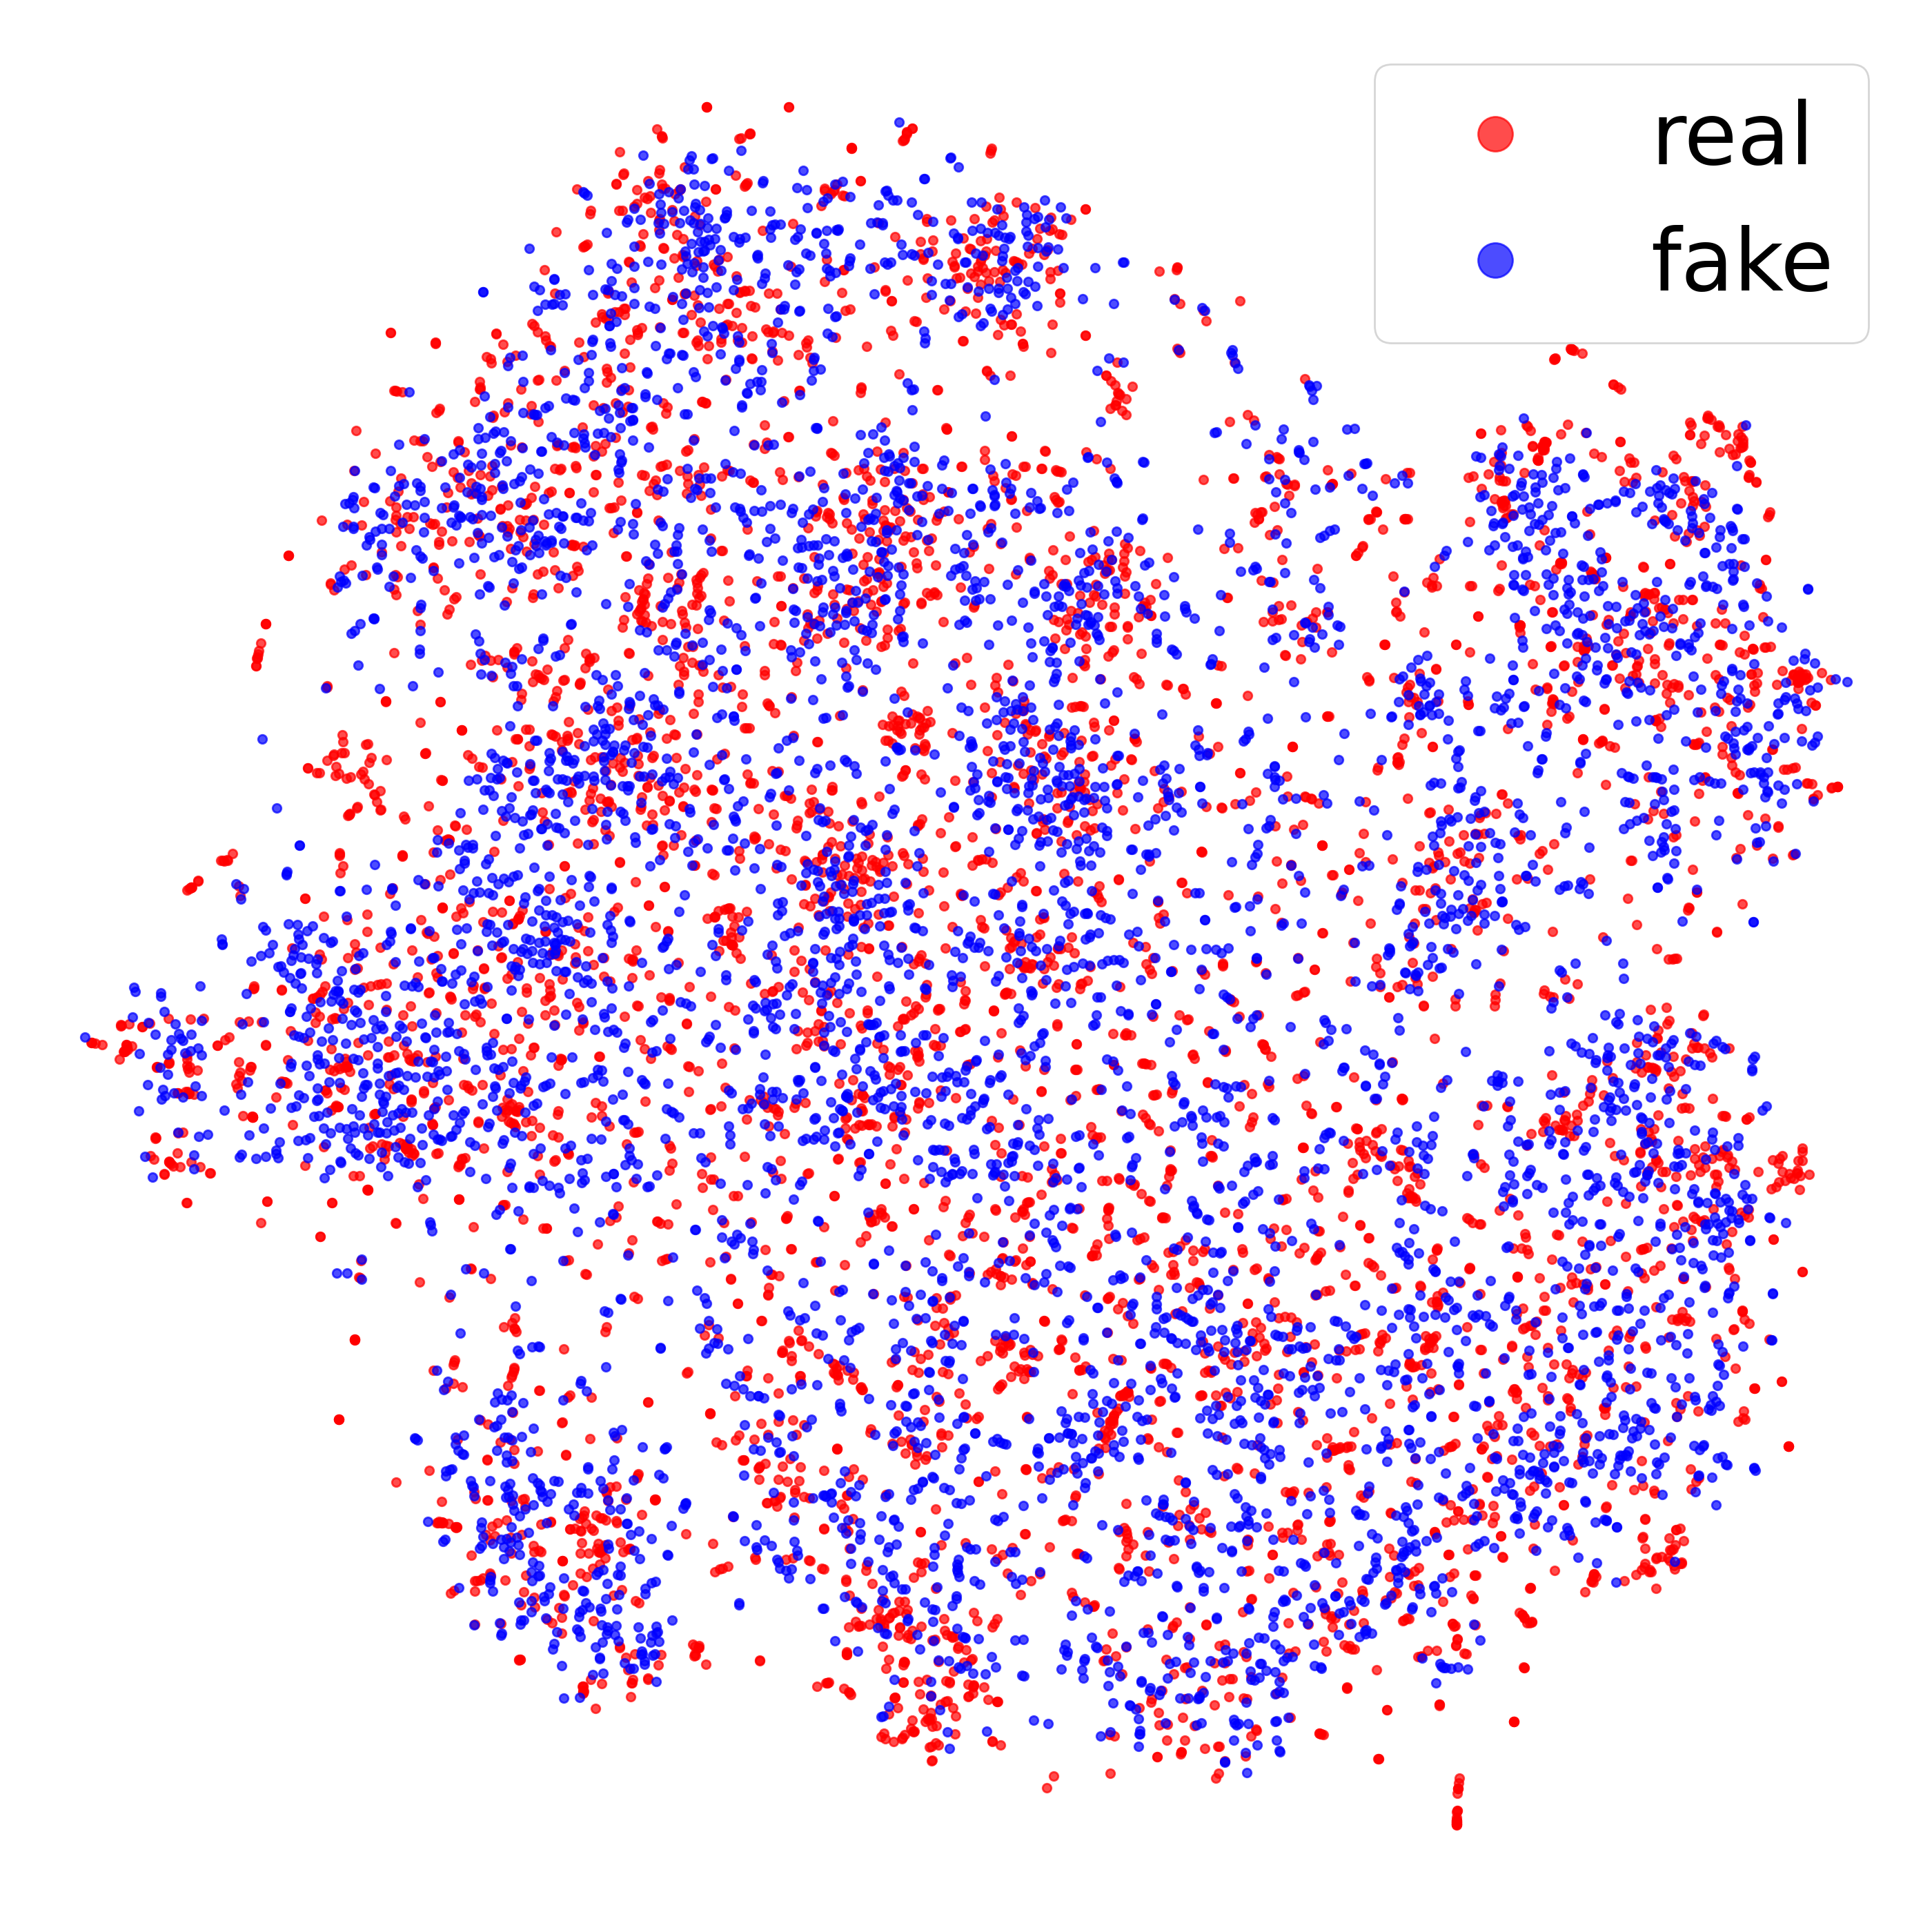
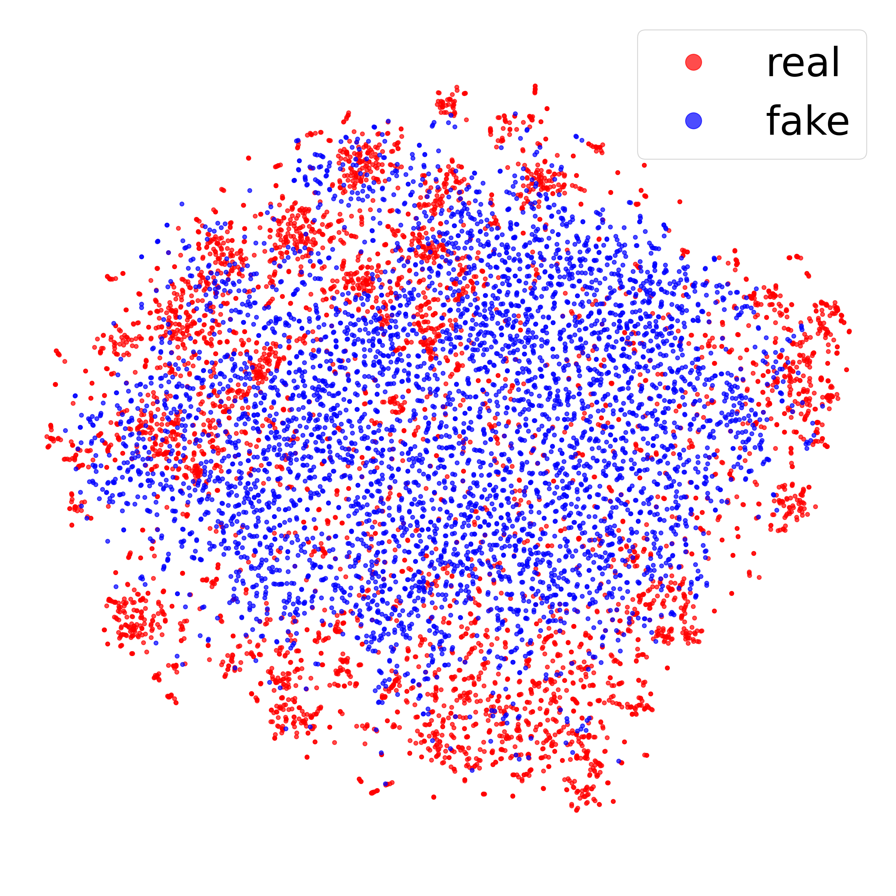
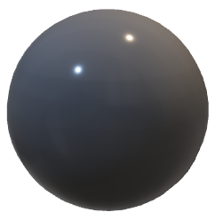
Adversarial training
Vanilla-GAN:
generator
vs discriminator
Ours
(GAN-based)
“real” / “fake”
DATASET
AMASS
VPoser
(VAE-based)
Generative Adversarial Nets. Goodfellow et al., NeurIPS, 2014
AMASS: Archive of Motion Capture As Surface Shapes. Mahmood et al., ICCV, 2019
Expressive body capture: 3d hands, face, and body from a single image. Pavlakos et al., CVPR, 2019
Notes:
The model is trained via adversarial learning in its basic formulation.
Random vectors are sampled from prior distribution and
fed to the trainable generative model that produces an SMPL pose.
Along with that we take real poses from the database.
Both real and fake vectors are fed to the discriminator model that must decide whether input pose is real.
If two counterparts are in balance, the distribution of generated poses covers the distribution of realistic poses, as we illustrate with t-SNE. We provide comparison with state-of-the-art VPoser that is based on Variational Autoencoder.

Slide 5
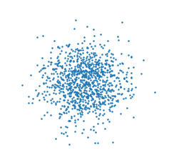

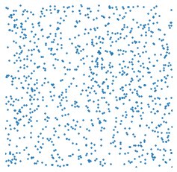

Prior distribution of latent vectors
bounded
no boundary
uniform
Standard Normal
GAN-N
❌
❌
Uniform
GAN-U
❌
Spherical
GAN-S
Notes:
We compare three different distributions for a latent prior: Normal, Uniform in the box and Uniform on the sphere.
The behavior of output poses will harshly depend on the properties of the input distribution.
So, we train three separate models to compare.

Slide 6
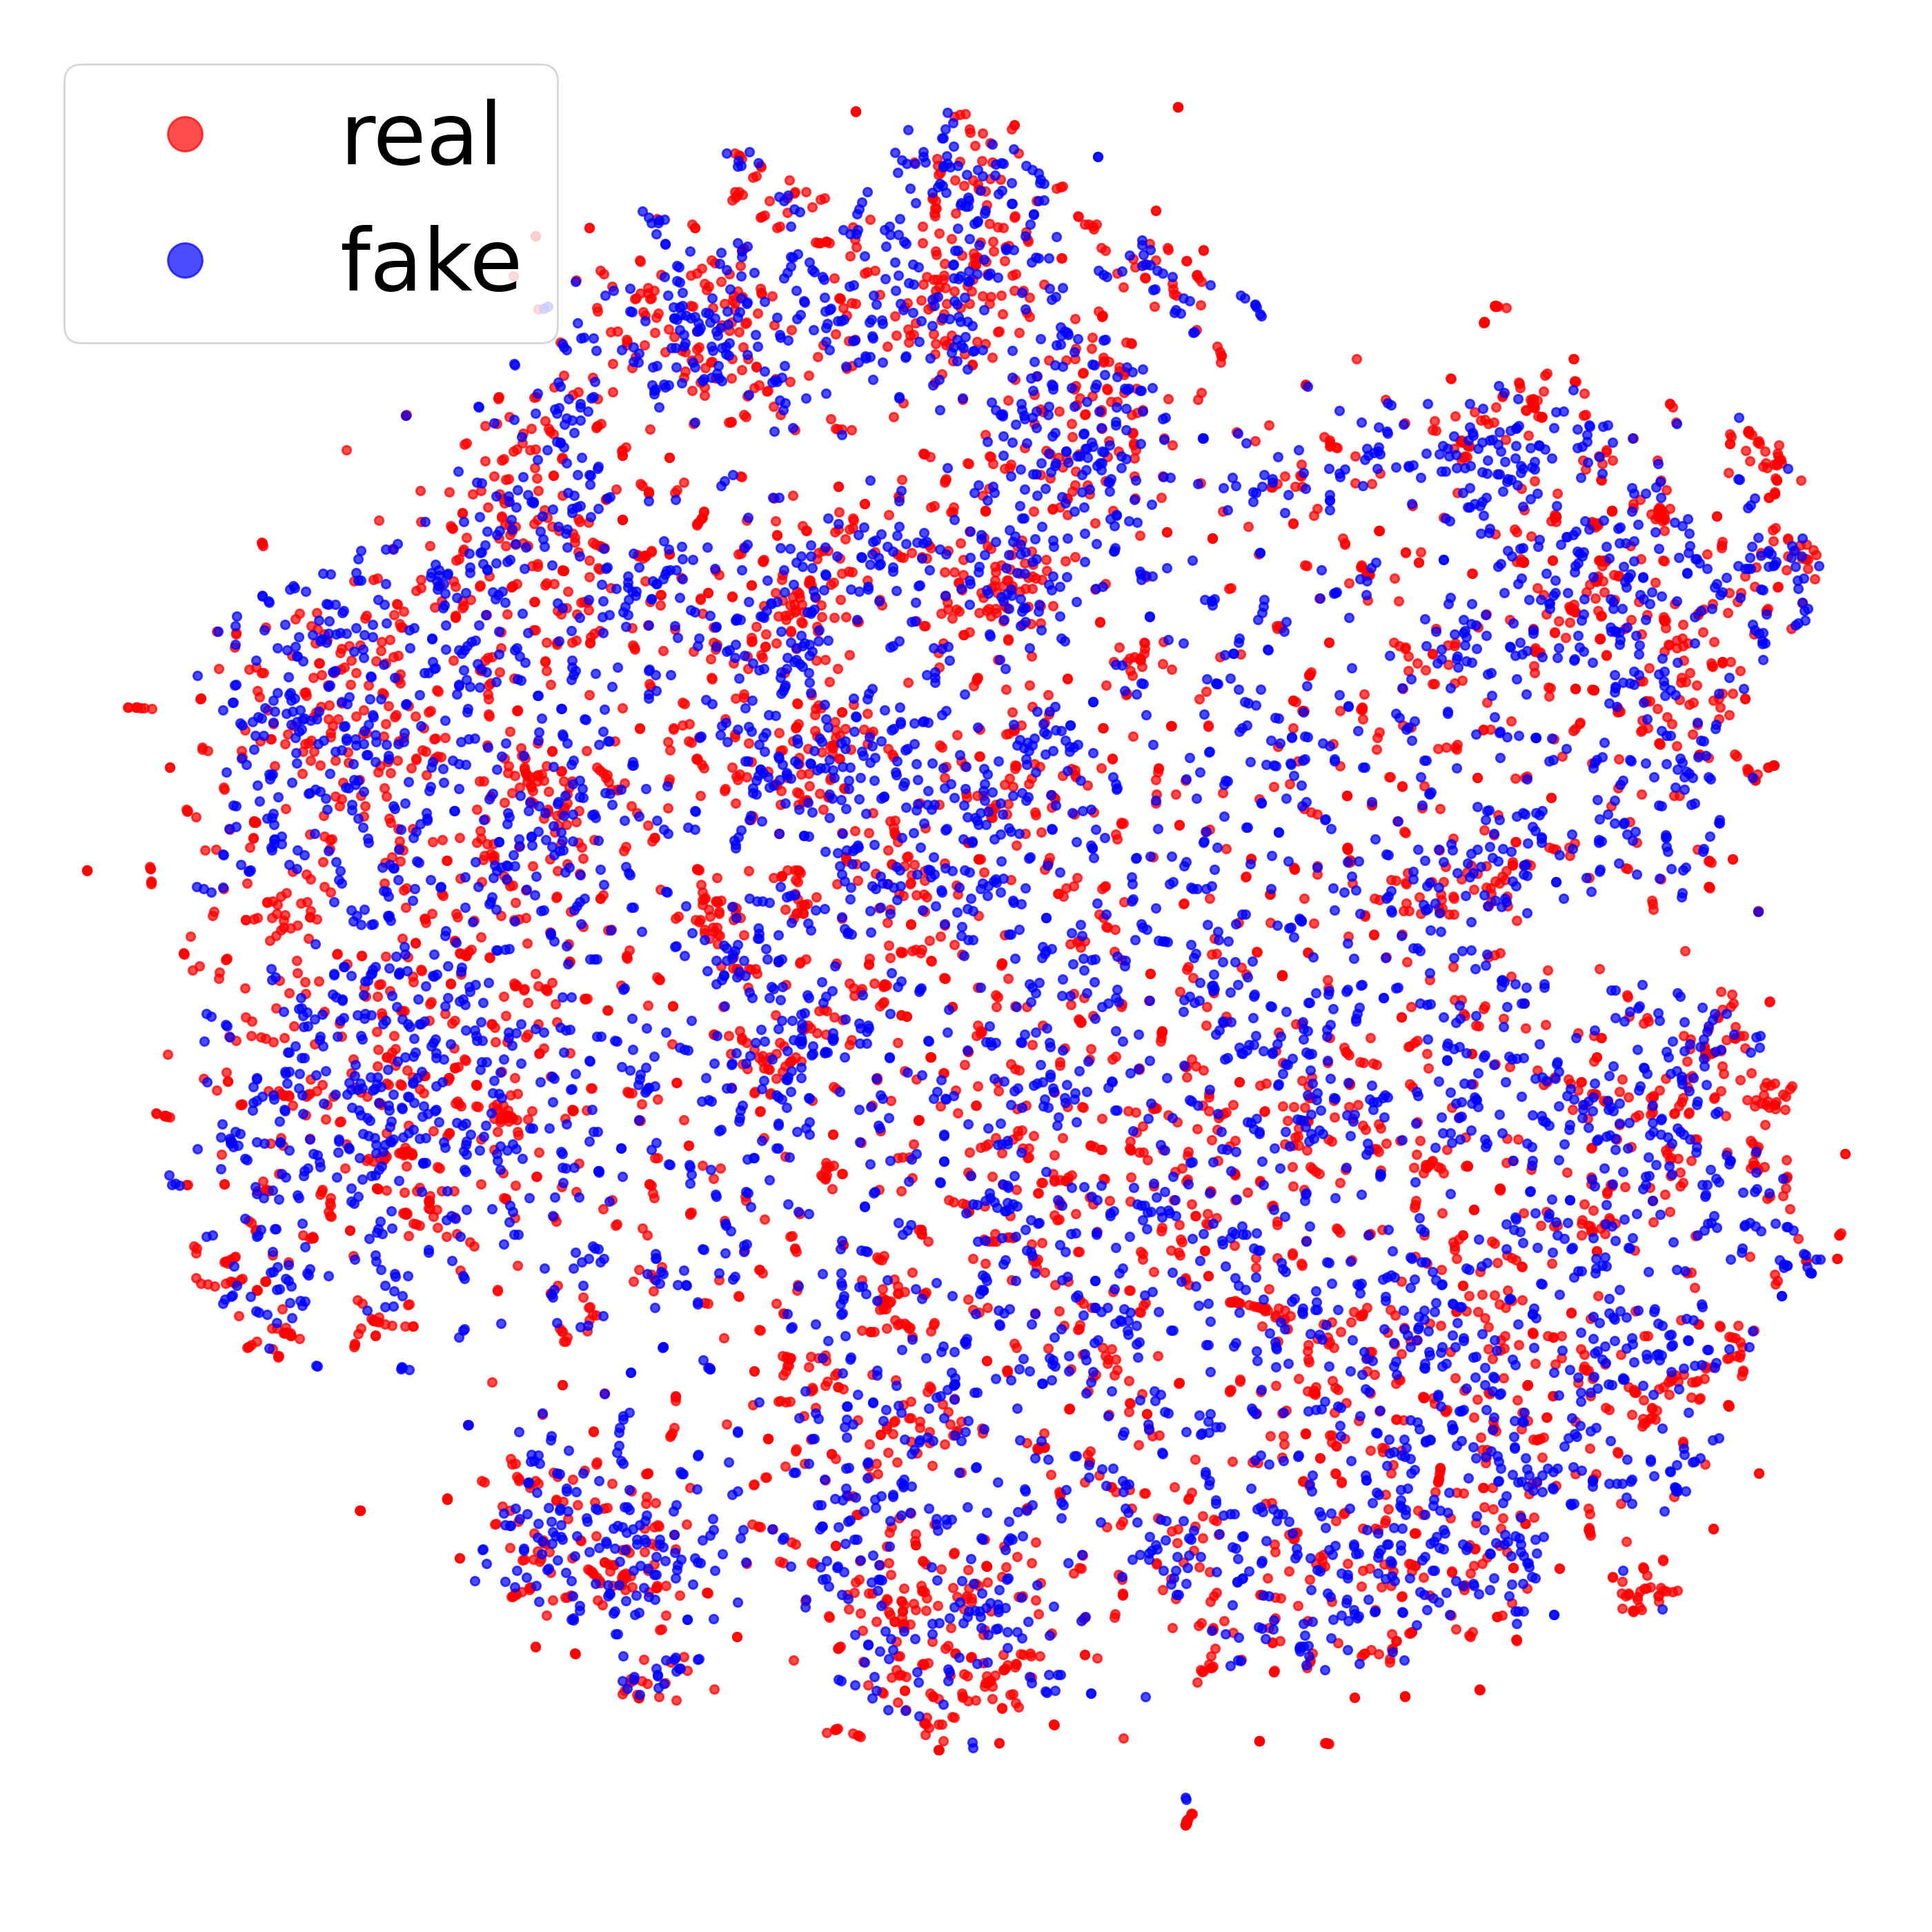
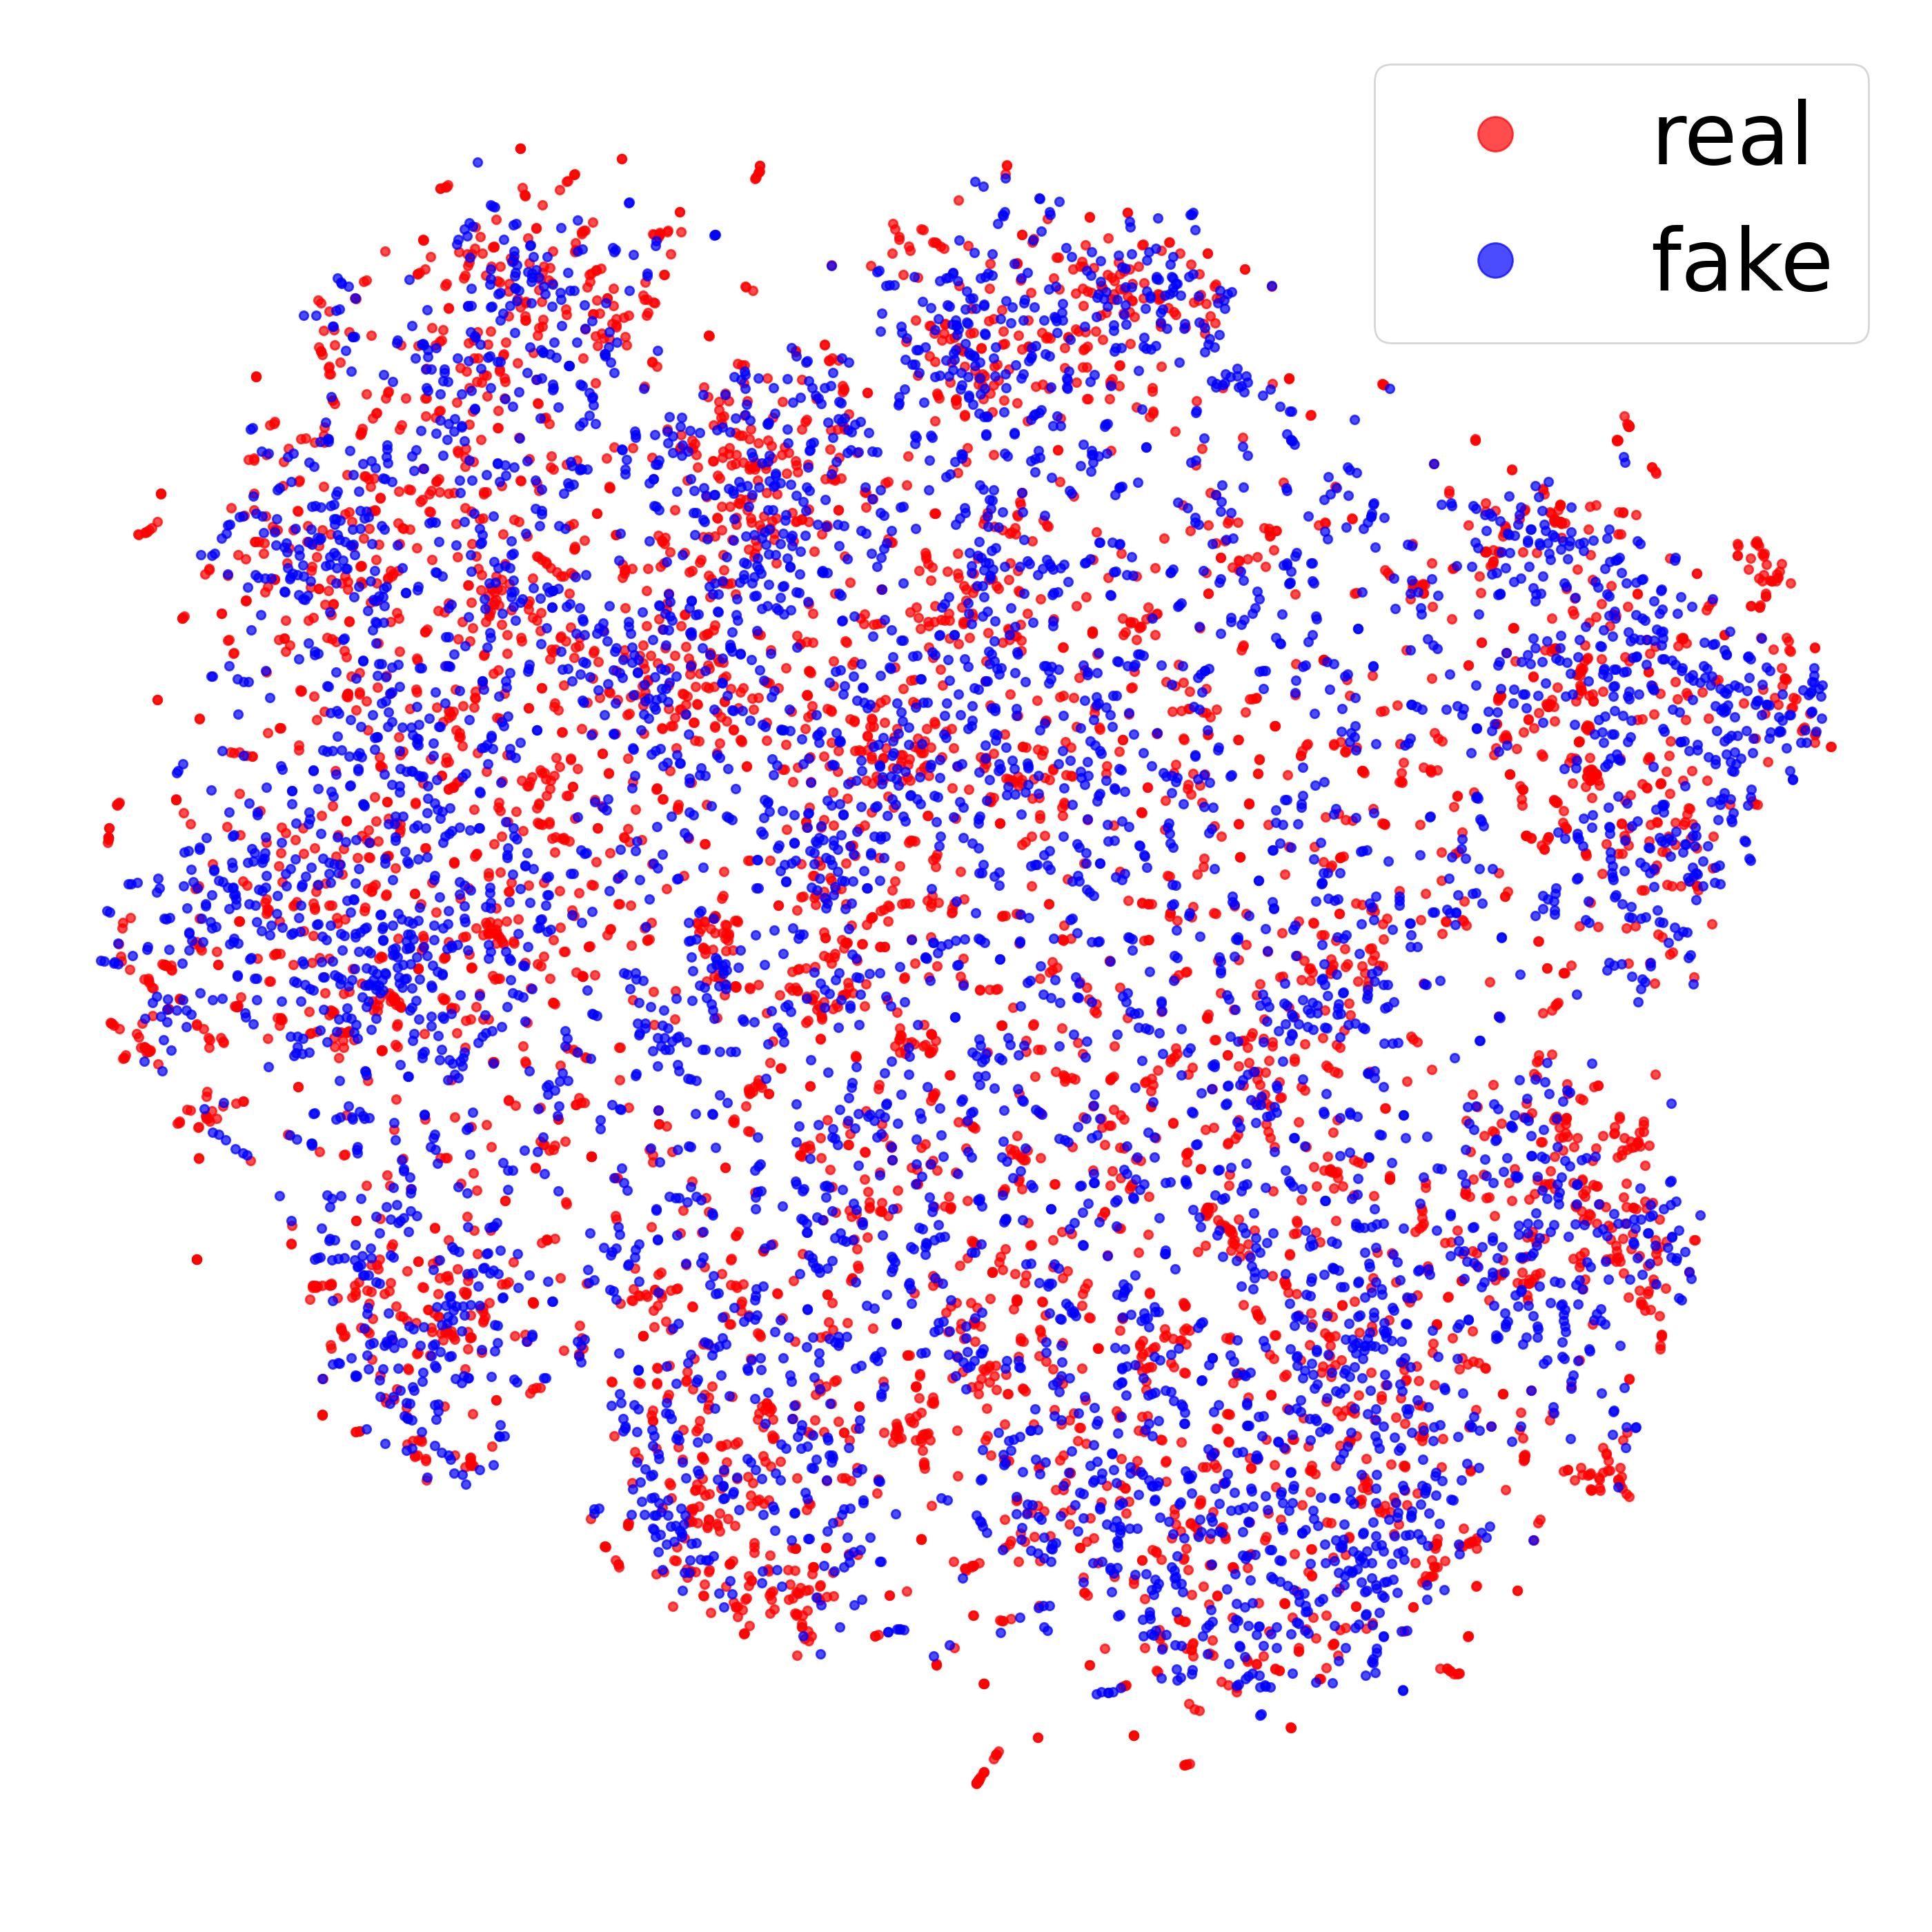
Data Coverage
Standard Normal
Uniform
Spherical
Notes:
We did not find any clear distinction between the models regarding the coverage over the distribution of real poses.

Slide 7
Interpolation Smoothness
fixed
LERP for GAN-U/N:
SLERP for GAN-S:
Notes:
However, experiments on smoothness of interpolation demonstrate rather peculiar yet predicted behavior. For every model, we sample pairs of points from each prior distribution.
Following the inherent topology of each space, we construct an interpolation sequence for each pair.
Using pretrained models we generate the sequences of poses, and then render the sequence of body meshes.

Slide 8
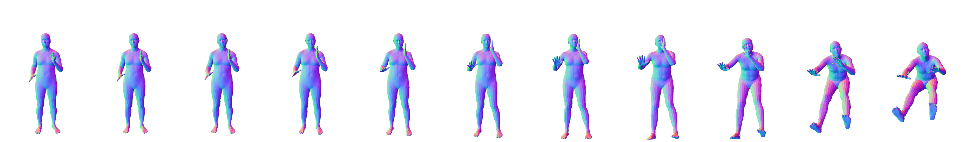
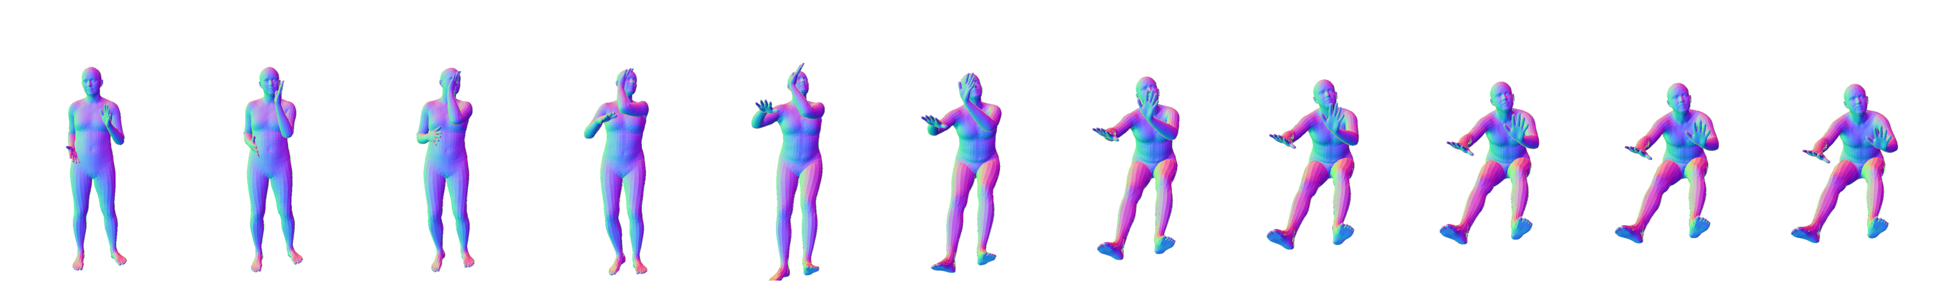
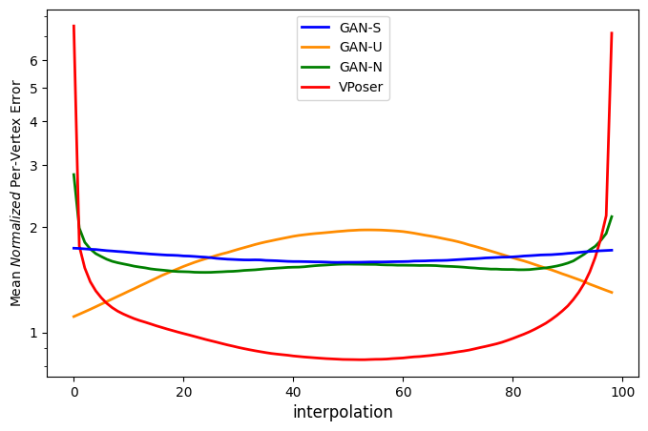
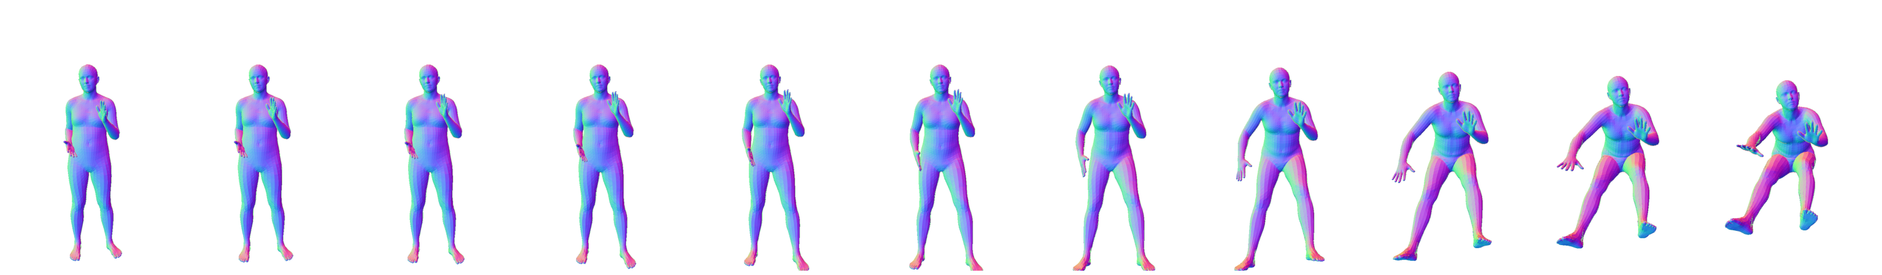
Interpolation Smoothness
MPVPE (Mean per-vertex position error)
GAN-S
N-MPVPE (Normalized)
GAN-U
GAN-N
VPoser
Expressive body capture: 3d hands, face, and body from a single image. Pavlakos et al., CVPR, 2019
Notes:
For fixed pairs of real meshes, we recover the corresponding latent vectors for each model
and draw the interpolation.
Fixed topology of SMPL meshes lets us quantify how smooth the interpolation is. To do that, we compute step-by-step mean per-vertex error and normalize it on the expected average step.
Hence, the error line computed along the path of the interpolation is expected to be as flat as possible for a perfectly smooth interpolation.
Our computations demonstrate how smooth the proposed GAN with Spherical prior distribution is, especially compared to VPoser model, where transitions are highly abrupt.

Slide 9
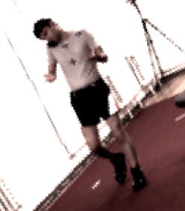
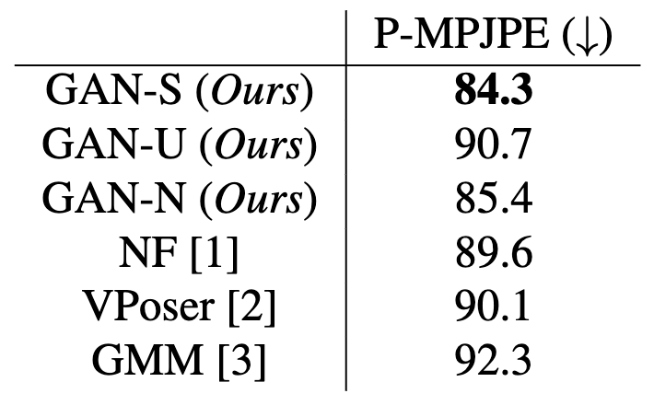
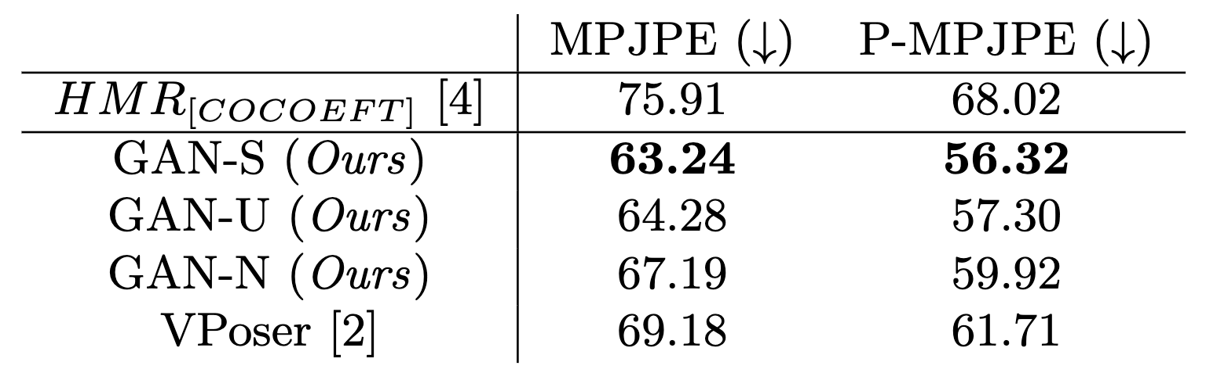
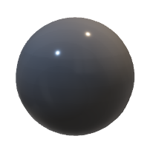
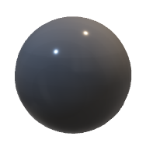
Mesh Optimization from 2D Joints
Image-to-Mesh Regression
fixed
Feature Extractor
SMPL regressor
fixed
?
fixed
[1] Weakly supervised 3d human pose and shape reconstruction with normalizing flows. Zanfir et al., ECCV, 2020
[2] Expressive body capture: 3d hands, face, and body from a single image. Pavlakos et al., CVPR, 2019
[3] Keep It SMPL: Automatic Estimation of 3D Human Pose and Shape from a Single Image. Bogo et al., ECCV, 2016
[4] Exemplar Fine-Tuning for 3D Human Pose Fitting Towards In-the-Wild 3D Human Pose Estimation. Joo et al., 3DV, 2021
Notes:
To illustrate how universal our prior is, we provide two more sets of experiments.
The first is body optimization given 2D image keypoints.
We optimize SMPL pose
through its latent representation.
We achieve state-of-the-art results on common benchmark Human3.6M.
Next task is direct regression of the 3D pose given the image of the person.
We take pretrained image resgressor. Our goal is to showcase that using our pretrained pose prior is beneficial.
Thus, we train an additional small MLP network that maps image features into the prior latent space,
from which we generate body poses using our models.
We tune an MLP using the same supervision as for the pretrained mesh regressor.
We prove that using our pretrained generative pose priors show an improvement at this task, too.

Slide 10

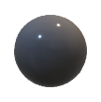
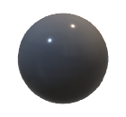
Adversarial Parametric Pose Prior
“real” / “fake”
DATASET
Feature Extractor
SMPL regressor
https://github.com/cvlab-epfl/adv_param_pose_prior
Notes:
To sum up,
we propose a new approach of SMPL pose modelling learning an adversarial prior.
Distribution of generated poses demonstrate very good coverage of the distribution of real poses.
At the same time, specifically chosen spherical input distribution provides better interpolation properties, compared to previously proposed unbounded models.
We achieve state-of-the-art results on such tasks as body recovery from image keypoints
And improvement in body pose estimation from the image.
Please, visit our github for more details.

